Slide 1
Student Performance Prediction System
Predicting final grades and flagging at-risk students
Mithraa RG | EMP ID: MIT14974 | Internship Project

Slide 2
Agenda
Problem and objective
Dataset and cleaning
1
2
EDA findings
Pipeline and models
3
4
Results and feature importance
Prediction system and conclusion
5
6

Slide 3
Problem and objective
Schools often learn a student is struggling only after the final result is in.
1
2
Predict the final grade
Flag At-risk students
Estimate a student's final grade (G3, out of 20) from student data.
Turn the predicted grade into a Pass / At risk label for early action.

Slide 4
Dataset and cleaning
UCI Student Performance dataset
395
33
0
0
students
columns
missing values
duplicate rows
The data was already clean, so no rows had to be dropped or imputed.

Slide 5
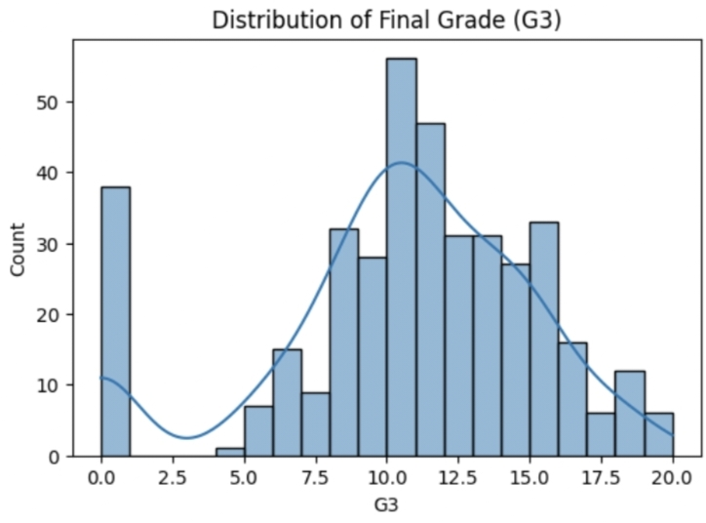
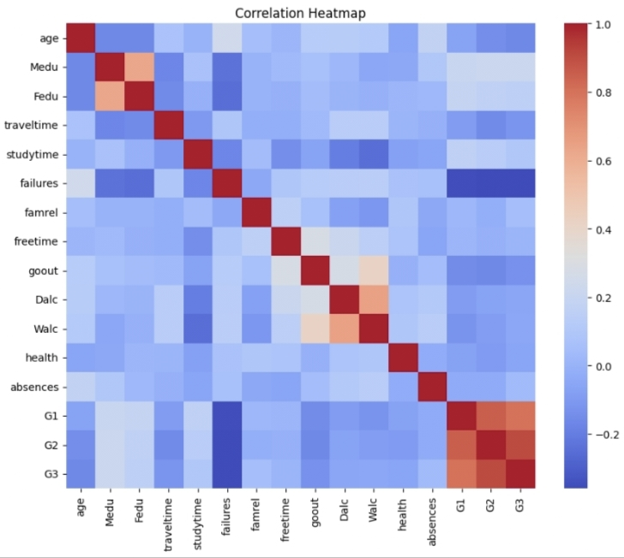
EDA findings
Grades cluster around 10 to 12, with a spike at 0
G1 and G2 correlate most strongly with G3
Failures correlate negatively with G3 (-0.36)

Slide 6
Project pipeline
1
2
3
Load data
Clean and check
Explore (EDA)
4
5
6
Encode features
Train and compare
Predict and flag

Slide 7
Models and method
39
80/20
2
features
train / test split
models compared
Categorical columns encoded into 39 model inputs
316 training rows, 79 test rows
Linear Regression vs. Random Forest

Slide 8
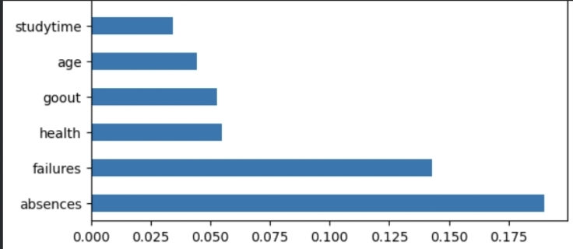
Results
Model | R²
Linear Regression (without G1, G2) | 0.141
Random Forest (without G1, G2) | 0.245
Random Forest (with G1, G2) | 0.815
Top features: absences, then failures
Removing G1 and G2 makes the model usable for early warning, but less accurate.

Slide 9
What drives the prediction
Absences matter most
Failures come second
Health, going out, age and study time contribute far less

Slide 10
Prediction system and conclusion
Limitations
Future work
Example output
Accuracy drops without G1 and G2
Small dataset of 395 students
Spike of zero grades is hard to predict
Add more data and more schools
Tune models and try other algorithms
Deploy as a simple web app
11.5 / 20
Pass
Predicted grade with Pass / At risk label

Slide 11
Key takeaways
G1 and G2
Previous grades are the strongest predictors of G3 (R² 0.815).
Early warning
Without G1 and G2 the model is less accurate (R² 0.245) but can flag risk sooner.
Risk factors
Absences and past failures drive the prediction most.

Slide 12
Thank you
Questions?
Mithraa RG | EMP ID: MIT14974

